Slide 1
AIRBNB BOOKING IN EUROPE.
INTRODUCTION:
We were analyzing the different Airbnb prices in the most popular European cities.
Each evaluated for different attributes e.g. room types, cleanliness and satisfaction ratings, bedrooms, distance from city centre and also capturing different prices on both the weekday and weekends.

Slide 2
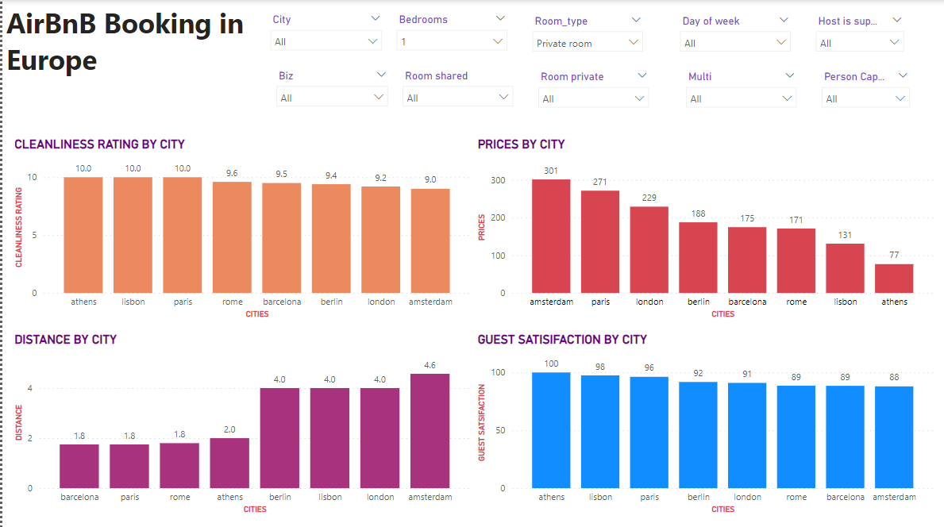
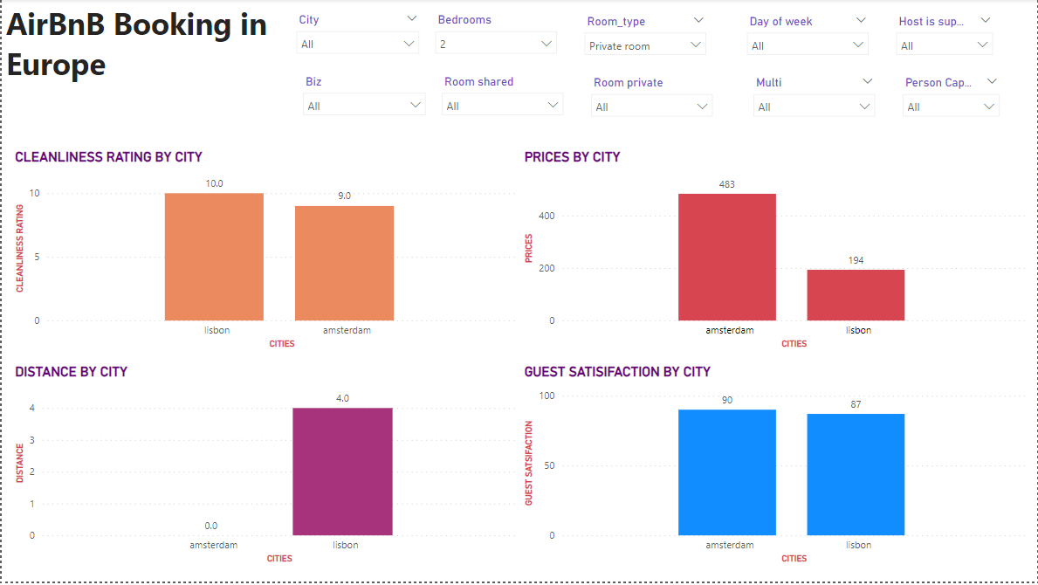
VISUALIZATION BY BEDROOMS;
In the 1 bedrooms; we can see that the cleanliness, distance and guest satisfaction does not affect the prices of the different cities. For example with Athens; it has the highest guest satisfaction and cleanliness but if you look at the prices – Athens has the cheapest price.
With the 2 bedrooms; Not all cities have airbnbs with 2 bedrooms thus being inconclusive.

Slide 3
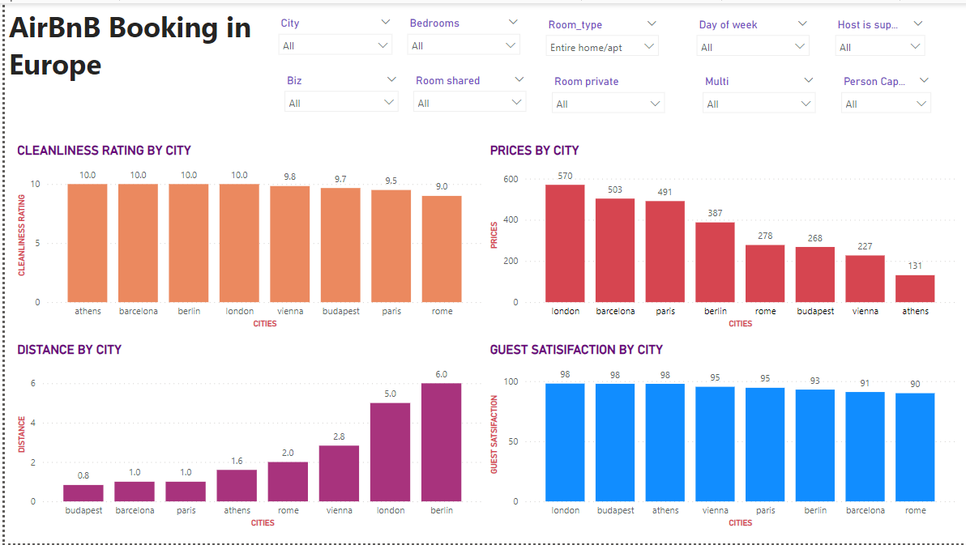
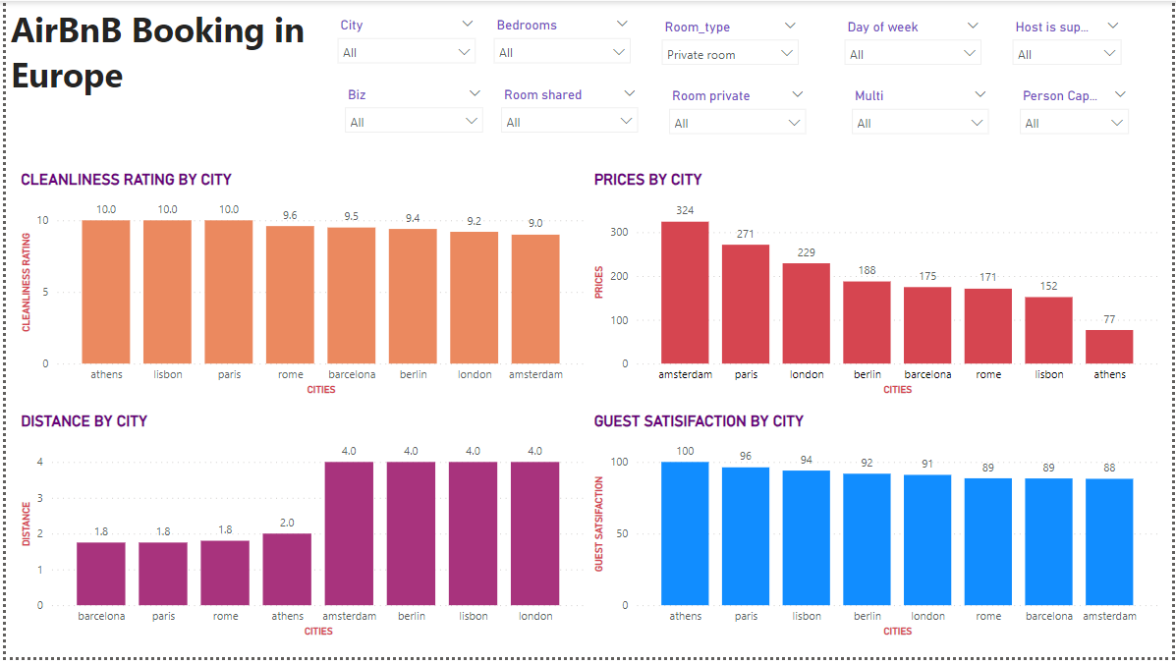
VISUALIZATION BY ROOM TYPE;
According to the room type; in the circumstances where the entire home/apartment was booked the prices in the cities were higher compared to where the private rooms were booked as they were lower.
The distance, guest satisfaction and cleanliness does not affect the prices of the city.

Slide 4
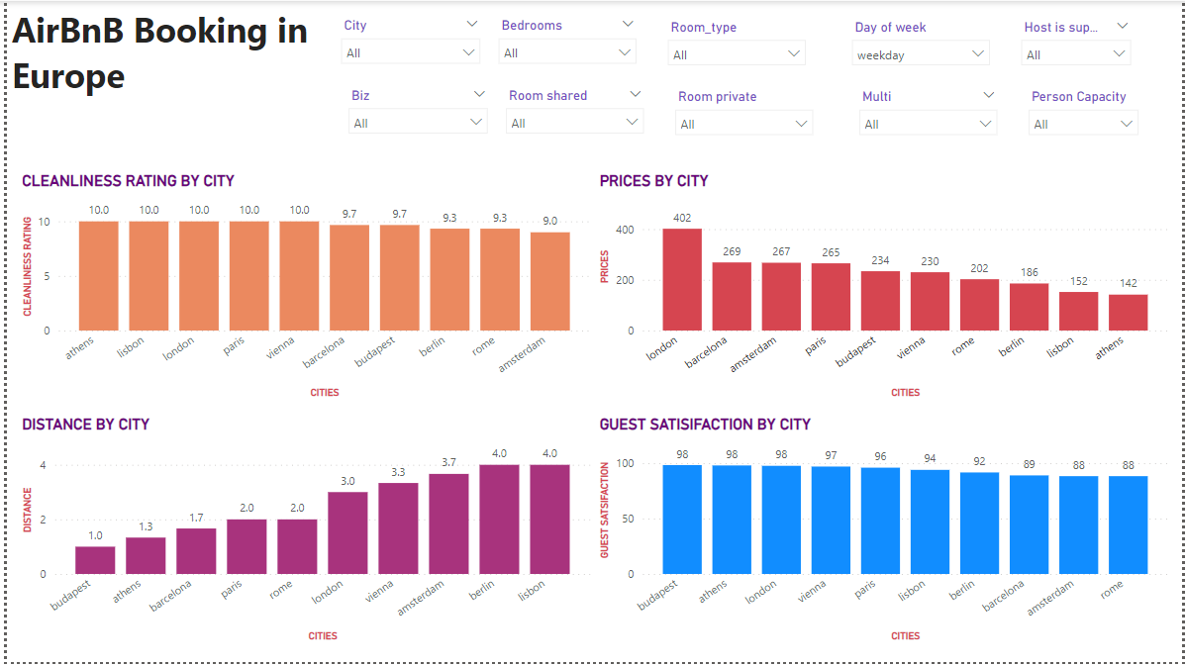
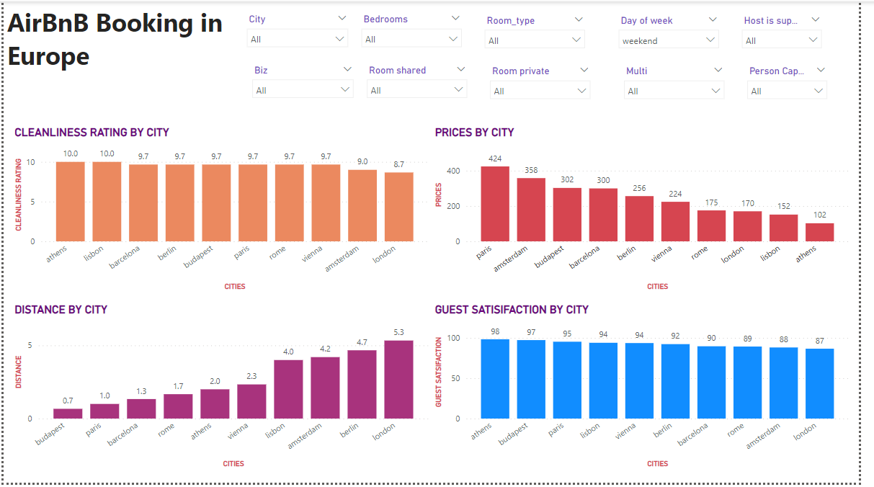
VISUALIZATION BY DAY OF WEEK;
The prices of the cities on the weekday were higher than the prices of the cities on the weekend. Also none of the other factors e.g. distance contributed to that.

Slide 5
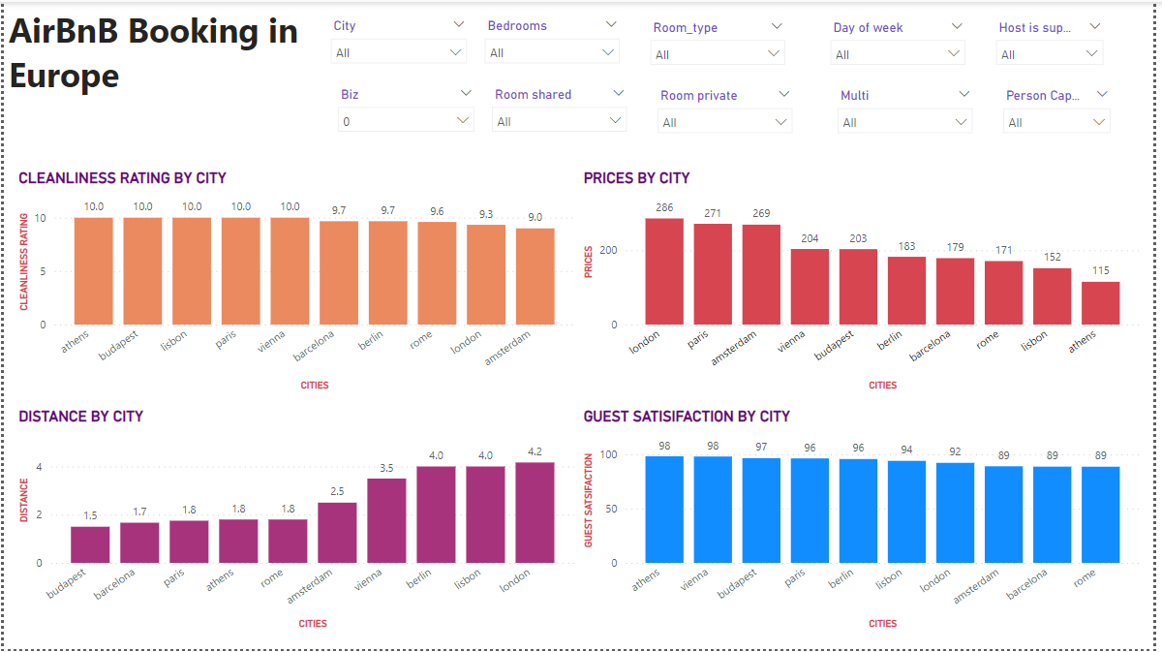
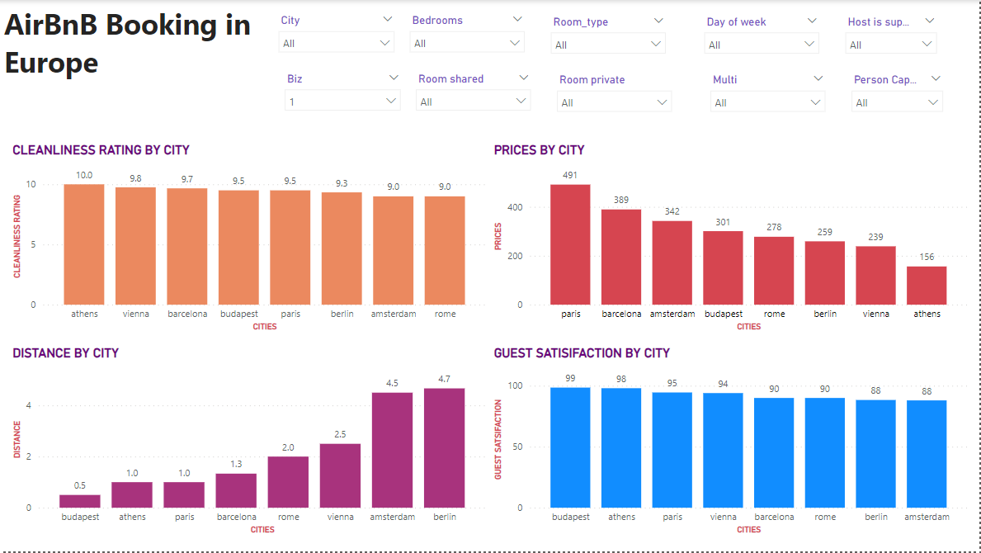
VISUALIZATION BY BUSINESS INDICATOR;
Business indicator affects the pricing but the cleanliness rating, distance and guest satisfaction do not have an impact on the prices based on the business indicator.

Slide 6
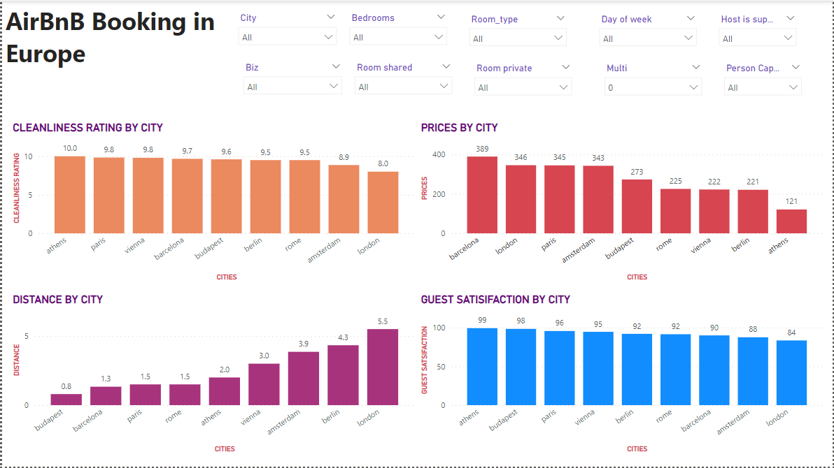
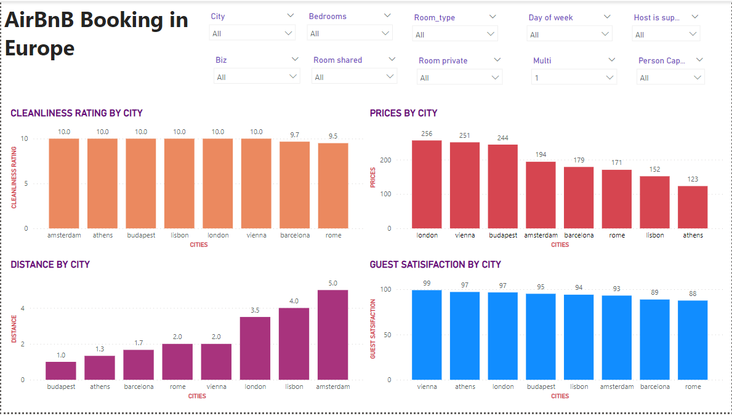
VISUALIZATION BY MULTIPLE ROOMS OR NOT;
The number of rooms in a business affects the pricing. The prices are higher for properties with single rooms than those with multiple rooms. However, the distance, cleanliness rating and guest satisfaction still doesn’t affect the pricing based on multiple rooms.

Slide 7
Conclusion
Based on the analysis that we’ve conducted, it is safe to say that the number of bedrooms, room type, and day of the weeks affect the pricing of AirBnBs in different cities. On the other hand, distance from the city, cleanliness ratings and guest satisfaction don’t have an impact on pricing and therefore the pricing is independent on these factors.

